Slide 1

Research Question –
Tutorial Presentation for Feedback
Date:
Group Name: Group B 165 Name of Student Presenting:

Slide 2
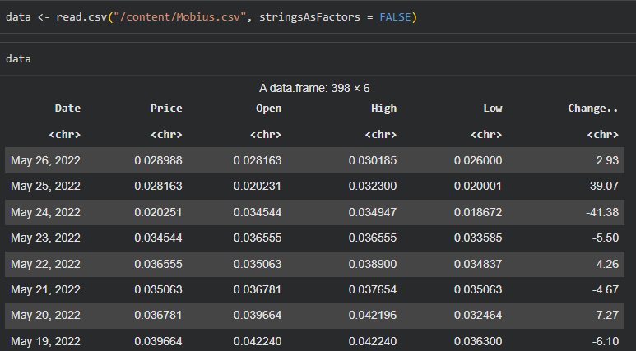
Dataset ID: Mobius.csv (extracted from IoT Coins Dataset)
Rows: 398
Variables used:
Independent Variable: Opening Price (interval)
Dependent Variable: Closing Price (interval)
Dataset Summary

Slide 3
This dataset is interesting to us because:
Mobius is a small-cap cryptocurrency with strong intraday price variation, making it ideal for studying opening–closing price relationships.
Variables used in our Research Question
Opening Price (Independent variable – interval / numeric)
Closing Price (Dependent variable – interval / numeric)
Dataset ID: DS300
Notes:
Before specifying your Research Question you must define the type of data you are analysing. Are the variables you select interval data (measurement data you can divide, multiple, etc), OR are they ordinal (there is a definite order but the intervals between each variable are not necessarily equal, or the terms might be subjective like in a likert scale); OR are they just categorical/nominal (Items such as film names, cities, etc., that you can count numbers of occurrences? You also need to understand whether the variable is either dependent or independent and this will vary according to the context. Independent variables may cause an effect, whereas the dependent variable might be effected by the independent variable. Check the lecture notes on the RQ for more information and examples.
You will get only one opportunity to present your Research Question ahead of the submission date. Have your questions ready, and be ready to take notes on feedback.

Slide 4
“Is there a significant correlation between the daily opening price (independent variable) and the daily closing price (dependent variable) for the Mobius cryptocurrency?”
This follows Template 1 (Correlation):
“Is there a correlation between dependent interval variable and independent interval variable?”
Our Research Question is

Slide 5
PRE 7COM1079-2025 Student Group No: B 165
Hypotheses
Null hypothesis (H₀):
There is no correlation between the opening price and the closing price of Mobius.
Alternative hypothesis (H₁):
There is a significant correlation between the opening price and the closing price of Mobius.

Slide 6
Scatterplot: Opening vs Closing Price
Shows the linear relationship between Opening (X-axis) and Closing Price (Y-axis).
A strong upward trend is visible, meaning higher opening prices generally lead to higher closing prices.
This directly supports our correlation-based RQ.
Visualisation Part 1 (Scatterplot)

Slide 7
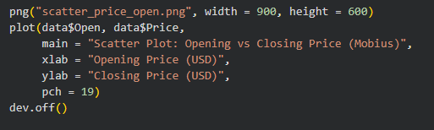
Visualisation Part 1 (Scatterplot Code)

Slide 8
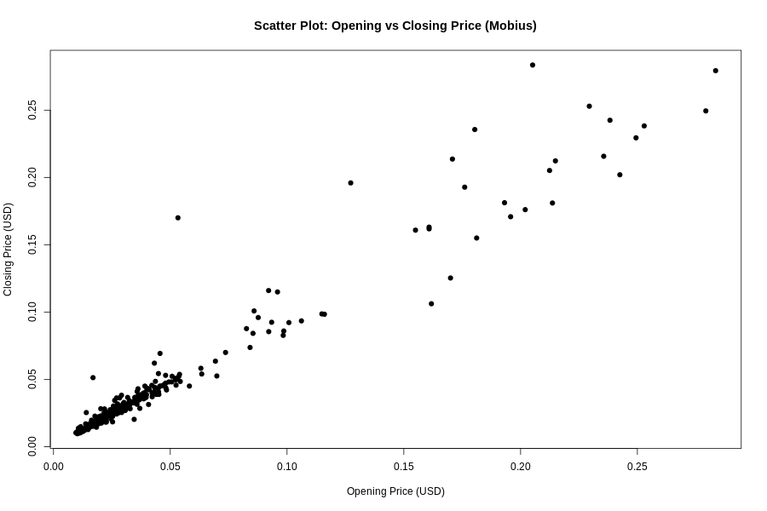
Visualisation Part 1 (Scatterplot)

Slide 9
Histogram of Daily Closing Prices
Displays how Mobius closing prices are distributed.
The distribution is right-skewed: most prices are low, but occasional peaks occur.
Histogram supports checking normality assumptions for Pearson’s correlation.
Visualisation Part 2 (Histogram + Normal Curve)

Slide 10
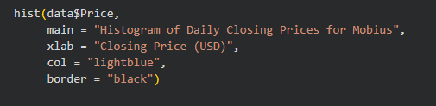
Visualisation Part 2 (Histogram Code)

Slide 11
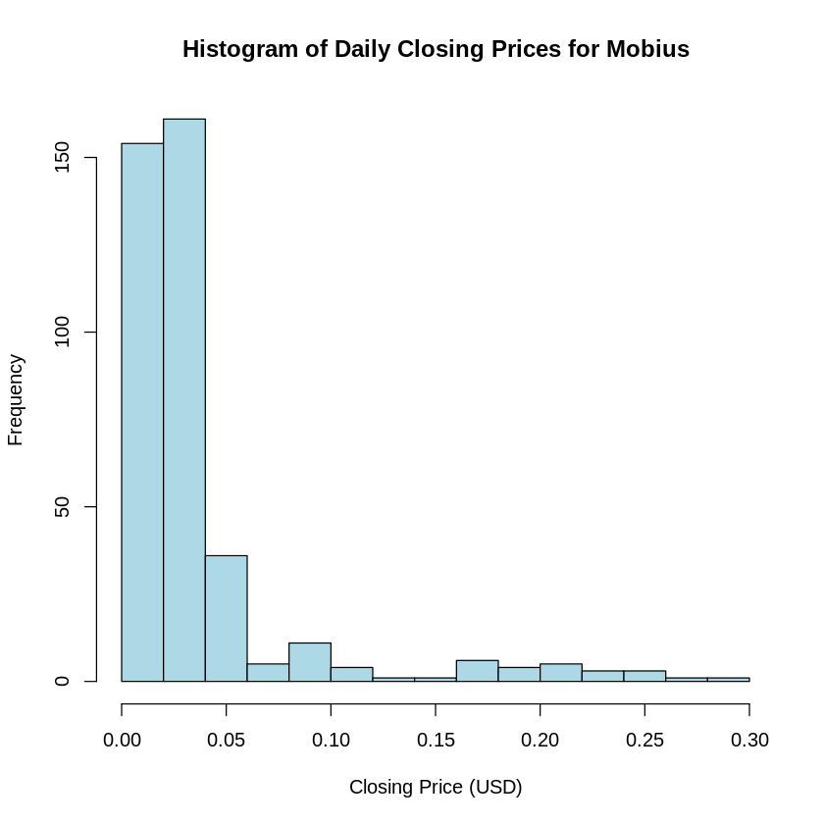
Visualisation Part 2 (Histogram + Normal Curve)

Slide 12

Statistical Test Used
We use Pearson’s correlation coefficient because:
Both variables (Opening and Closing Price) are continuous interval data.
Pearson’s r measures linear association, which fits our scatterplot pattern.
Commonly used in financial time-series analysis.
Analysis: Statistical Test

Slide 13
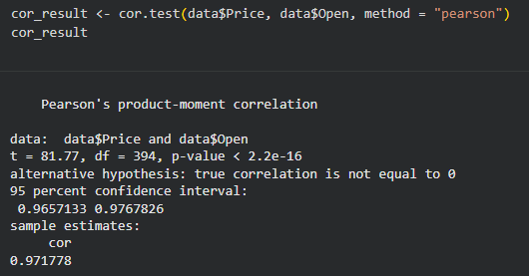
Pearson’s Correlation Test Output:
Correlation (r): 0.9718 p-value < 2.2e-16
95% CI: 0.9657 – 0.9768
Decision: p < 0.05 → Reject H₀
Statistical Output & Interpretation

Slide 14
Interpretation:
The correlation is very strong and positive (r ≈ 0.97). This means when Mobius opens at a high price, it almost always closes high too. Indicates high intraday consistency, suggesting stable market behaviour for this asset. Supports existing financial literature showing structured intraday movement in crypto markets.
Statistical Output & Interpretation

Slide 15
There is a strong and significant correlation between opening and closing prices.
This allows us to reject the null hypothesis.
Mobius demonstrates predictable daily price movement, meaning opening price is a good indicator of closing price.
Future work could explore: Non-linear relationships
Volatility clustering
Comparing Mobius with other cryptocurrencies
Conclusion

Slide 16
THANK YOU

